Slide 1
Superheroes Unite!
ACTIVITY PACK
Work through each sheet in order, or share out the responsibilities between your group, there are many ways to approach the activities here.
Your mission: assemble our DSH friends into a spectacular superhero team.

Slide 2
Superheroes Unite: Our DSH Friends
A few short weeks ago six friends arrived at the DSH offices and told us they'd like to join our team and help us by solving digital disasters.
They like playing games, and love a good mystery, so they decided to not really tell us too much about themselves. In fact, the only thing we know about them is that each of them has a unique special power. These are:
Team player
Problem solver
Leader
Creator
Explorer
Storyteller

Slide 3
Introducing the DSH Friends.
Meet the our six friends, each one has their own special power.
Team player
Problem solver
Leader
Explorer
Creator
Storyteller

Slide 4
We need your help.
Our new friends are playing a game with us. They’ve agreed to become our digital superheroes and help solve digital problems. But before they do that, we need to create a superhero profile for each of them, one that we think suits them. The more we know about them, the more effectively we can get them to work together solving problems that they are best suited to.
This is where we need your help. Your our team of creative writers and we need you to bring our DSH friends to life. Each DSH friend will need:
A name
A personality: likes and dislikes
A back story
…and we also need a group name! So let’s get started shall we?

Slide 5
What type of personality do I have?
Fill in the table below to list the types of things that this superhero likes and dislikes. Are there any key personality traits that they have?
Likes | Dislikes
e.g. likes making funny videos with friends | e.g. doesn’t like cake
Team player.

Slide 6
What’s my name?
FINAL NAME:
What would the ideal name be for this superhero? Brainstorm some suggestions below. When you decide on the final name, write it in the box above.
Team player.

Slide 7
What type of personality do I have?
Fill in the table below to list the types of things that this superhero likes and dislikes. Are there any key personality traits that they have?
Likes | Dislikes
e.g. likes playing and solving puzzle games | e.g. doesn’t like hamsters
Problem solver.

Slide 8
What’s my name?
FINAL NAME:
What would the ideal name be for this superhero? Brainstorm some suggestions below. When you decide on the final name, write it in the box above.
Problem solver.

Slide 9
What type of personality do I have?
Fill in the table below to list the types of things that this superhero likes and dislikes. Are there any key personality traits that they have?
Likes | Dislikes
e.g. likes being captain of the netball team | e.g. doesn’t like cake
Leader.

Slide 10
What’s my name?
FINAL NAME:
What would the ideal name be for this superhero? Brainstorm some suggestions below. When you decide on the final name, write it in the box above.
Leader.

Slide 11
What type of personality do I have?
Fill in the table below to list the types of things that this superhero likes and dislikes. Are there any key personality traits that they have?
Likes | Dislikes
e.g. likes travelling | e.g. doesn’t like ice cream
Explorer.

Slide 12
What’s my name?
FINAL NAME:
What would the ideal name be for this superhero? Brainstorm some suggestions below. When you decide on the final name, write it in the box above.
Explorer.

Slide 13
What type of personality do I have?
Fill in the table below to list the types of things that this superhero likes and dislikes. Are there any key personality traits that they have?
Likes | Dislikes
e.g. likes playing with LEGO | e.g. doesn’t like dancing
Creator.

Slide 14
What’s my name?
FINAL NAME:
What would the ideal name be for this superhero? Brainstorm some suggestions below. When you decide on the final name, write it in the box above.
Creator.

Slide 15
What type of personality do I have?
Fill in the table below to list the types of things that this superhero likes and dislikes. Are there any key personality traits that they have?
Likes | Dislikes
e.g. likes reading | e.g. doesn’t like cats
Storyteller.

Slide 16
What’s my name?
FINAL NAME:
What would the ideal name be for this superhero? Brainstorm some suggestions below. When you decide on the final name, write it in the box above.
Storyteller.

Slide 17
What’s the group
name?
FINAL GROUP NAME:
Now that we know the names and personalities of each different DSH friend, can we come up with a name for the entire group? Brainstorm your suggestions below and write your final choice in the box.

Slide 18
Everyone has a story to tell.
Every superhero has a story. It might be a story about how they got their special powers or a story about how they used their powers to help save the world. Our DSH Friends help save people from digital disasters, but what’s their story? How did they come to life? Can you help us work this out? Tell the story for us and bring our characters to life.
Use the following pages to write a story. Here are some suggestions to get you started:
1. Introduce one or more of the characters:
What did they do before they joined the group?
How did they get their special powers? Were they born with them?
2. How did the 6 characters become friends?
When did they meet?
Were they always friends?
Why did they decide to become a team?
Do they have a mission or an aim? What is it?
3. Operation Sandbox...describe an incident where the DSH friends had to use their special powers to save the day:
What happened?
When and where did this happen?
Who was involved?

Slide 19
My story.
Which characters are included in your story?
Write your story in the space below.
TITLE:

Slide 20
My story.
Which characters are included in your story?
Write your story in the space below.

Slide 21
My story.
Which characters are included in your story?
Write your story in the space below.

Slide 22
My story.
Which characters are included in your story?
Write your story in the space below.

Slide 23
My story.
Which characters are included in your story?
Write your story in the space below.

Slide 24
My story.
Which characters are included in your story?
Write your story in the space below.

Slide 25
My story.
Which characters are included in your story?
Write your story in the space below.

Slide 26
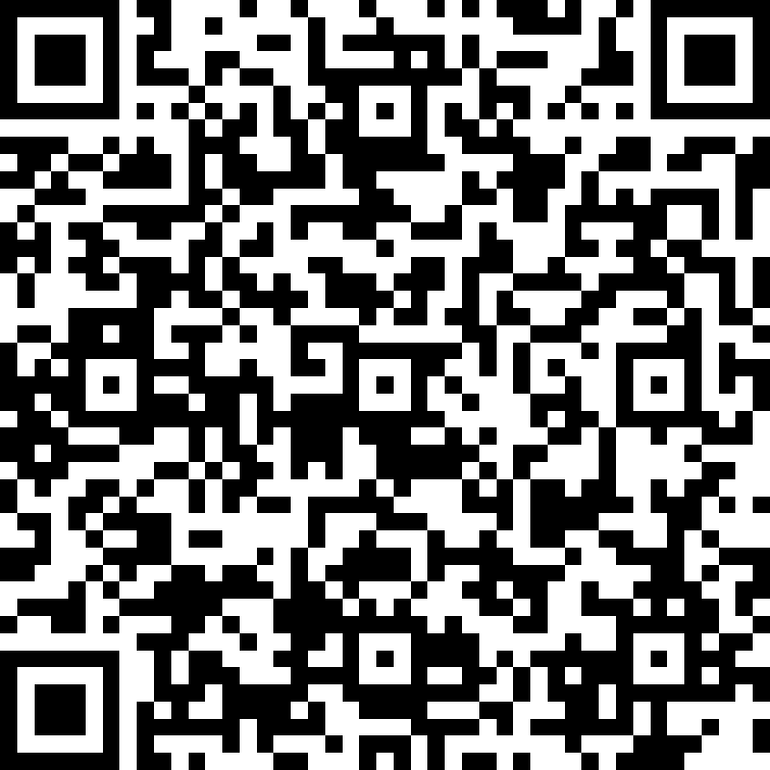
Share your stories with us.
Fill in your details HERE or by QR code below.
Send in any documents by wetransfer to dsh@ukie.org.uk
Deadline: Thursday 20 August 2020

